Slide 1
Terraform for Azure

Slide 3

About
Leandro Prado – leandro.prado@microsoft.com
Cloud Solution Architect
Apps and Innovation - DevOps

Slide 4
Agenda
Date: 14/01/2025
Timetable:
09:00 - 12:00 - Conteúdo
12:00 - 14:00 - Almoço
14:00 - 18:00 - Conteúdo

Slide 5
Modules
Module 01 - Infrastructure as Code
Module 02 - Terraform Introduction
Module 03 - Terraform Basic
Module 04 - Terraform Module
Module 05 - Terraform with GitHub Copilot and Actions

Slide 6
Terraform to Azure Module 01 - Infrastructure as Code

Slide 7
Overview
After completing this learning unit, you will understand
What is Infrastructure as Code (IaC)?
Azure Resource Manager
Azure Bicep
Terraform

Slide 8
What is Infrastructure as Code?

Slide 9
What is Infrastructure as Code (IaC)?
Infrastructure as Code (IaC) tools allow you to manage infrastructure with configuration files rather than through a graphical user interface.
IaC allows you to build, change, and manage your infrastructure in a safe, consistent, and repeatable way by defining resource configurations that you can version, reuse, and share.

Slide 10
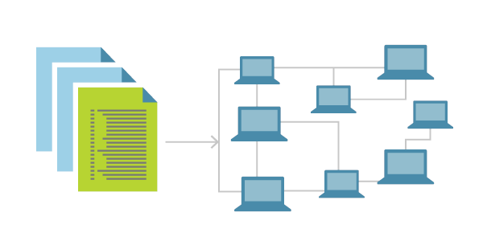
Benefits of IaC
Consistent and repeatable environments
Versioning managed as source code
Enables continuous delivery
Quick deployment of multiple environments
Code review decreases errors and increases accountability

Slide 11
Imperative vs. Declarative
Classic Programming describe how it is done
Idempotence has to be taken care by programmer
Create Gen 2 Storage Account “myStorage”, if not yet existing
Describe resulting components
Desired state, but not how it is deployed
Implicitly idempotent
Expect Storage account with name “myStorage“ as Gen 2

Slide 12
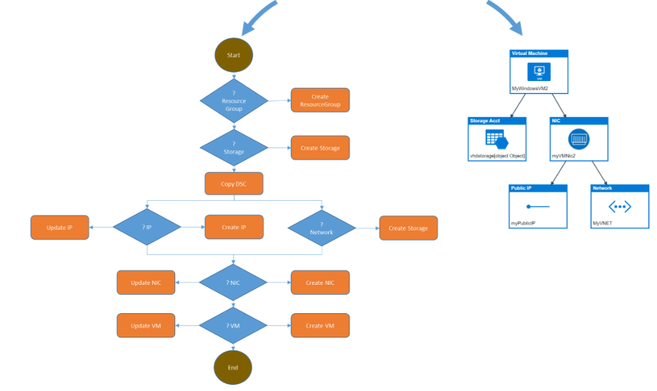
Imperative vs. Declarative

Slide 13
Tools
Azure Resource Manager (ARM Template)
Bicep
Terraform

Slide 14
Azure Resource Manager

Slide 15
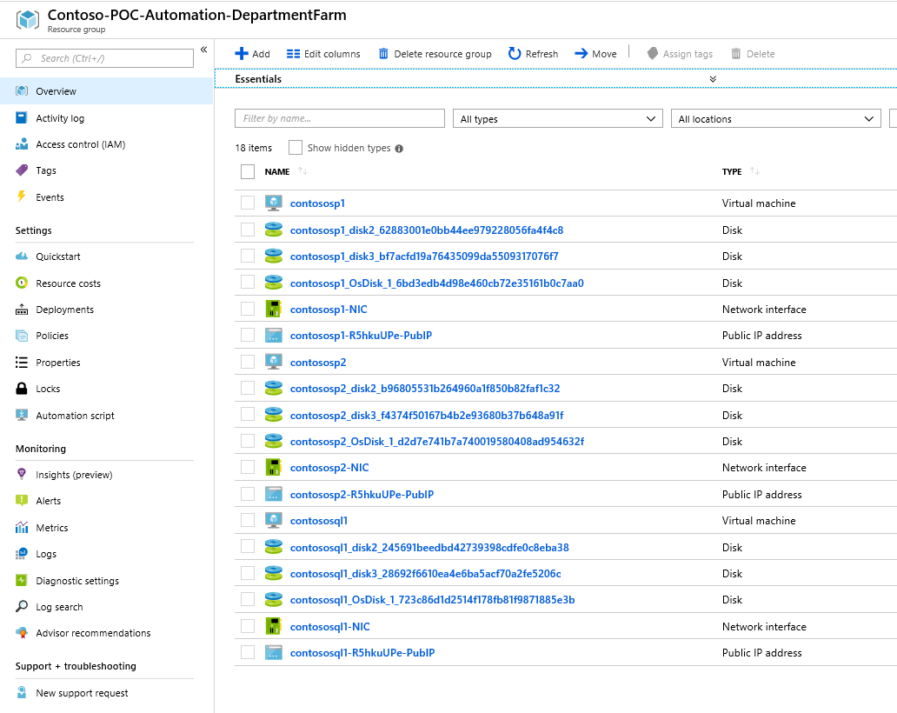
Azure Resource Manager
Infrastructure for your application
Related and interdependent parts of a single entity
Work with the resources in your solution as a group

Slide 16
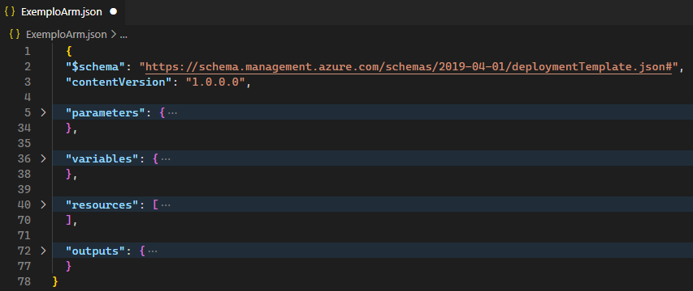
ARM Template Overview
Create ARM Template definition (JSON Format)
Repeat deployments using templates
Portal solutions include deployment templates

Slide 17
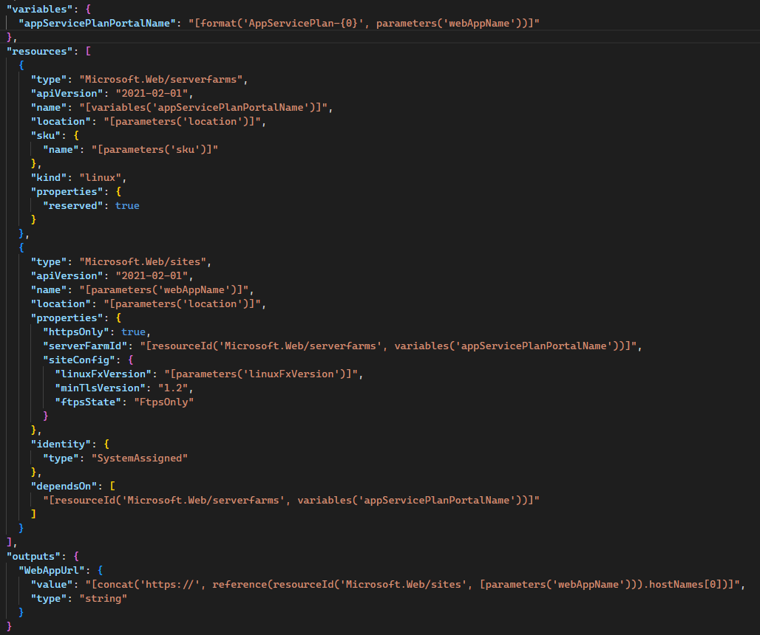
ARM Template Example

Slide 18
ARM References
Microsoft Quick Start templates:
https://azure.microsoft.com/en-gb/resources/templates/
Azure QuickStart templates on GitHub:
https://github.com/Azure/azure-quickstart-templates
Basic ARM template:
https://github.com/Azure/azure-quickstart-templates/tree/master/101-vm-simple-windows

Slide 19
Azure Bicep

Slide 20




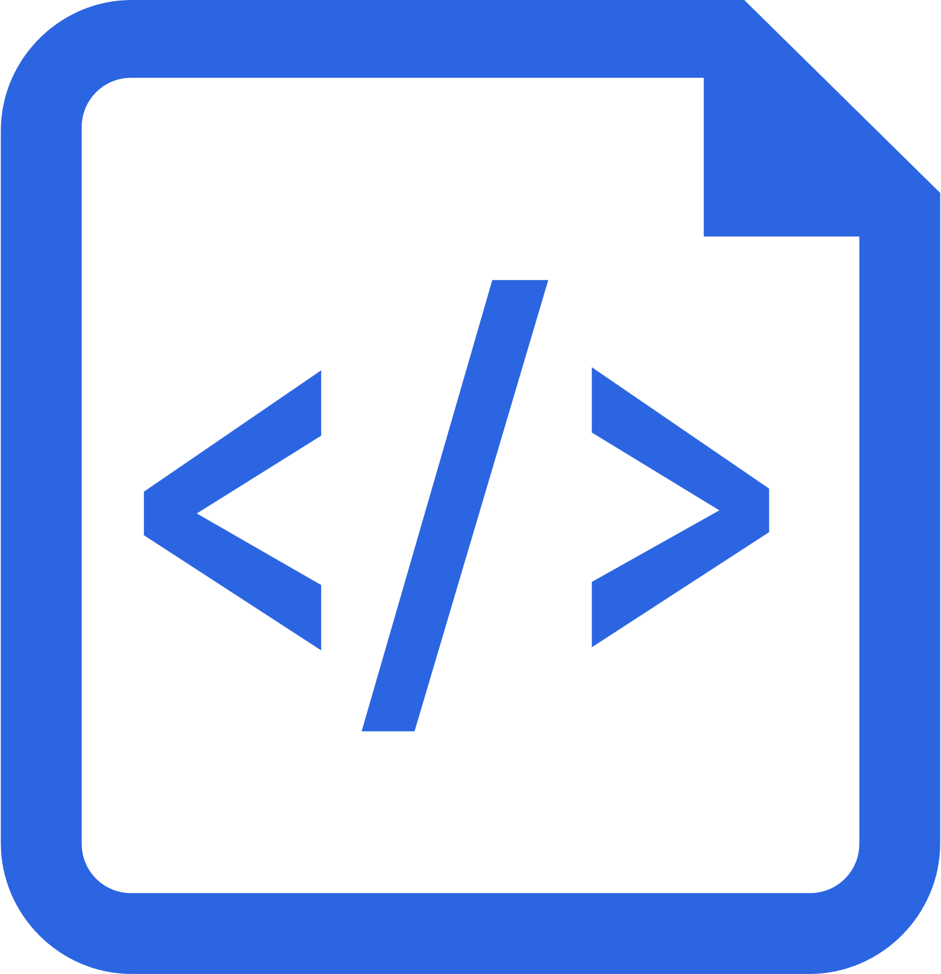
Benefits of Azure Bicep
Simple declarative files for creating Azure resources in a reliable, repeatable and auditable way.
Simpler Syntax. No JSON noise
Define Azure resources using a simple language to learn, read and understand.
Declarative Syntax
Declare how the resources should be and Azure Resource Manager “makes it so”.
Modularity
Modules to break your bicep code into manageable chunks. Public and Private module registries
Built for tool-ability
First class authoring experience in VSCode. Rich type-safety, intellisense and validation.
Convert existing templates
Easy conversion of ARM Templates to Bicep
https://aka.ms/BicepDocs
Notes:
More readable and write-able syntax. No JSON noise.
Day Zero support for all Azure resource types.
No state management. State is managed by the Azure platform.
Richer type-safety, validation, IntelliSense. Built for Toolability.
Modules to break your bicep code into manageable chunks.
Integrated into the platform (Export Templates, Remediate resources with templates in policy)

Slide 21

Bicep vs other tools
Day zero support for all resource types & API versions
Bicep templates are generated based on resource schema. All preview and GA services can be created using Bicep from Day Zero.
No state files
No state management. Can query the state directly from Azure.
Deep integration with Azure Governance Services
Azure Policy remediation for non-compliant resources are done via Bicep. TemplateSpecs can be a source for modules. Bicep Landing Zones and Blueprints
100% free and open source
No paying for ‘premium’ capabilities and 100% supported by Microsoft support
Automate Portal actions
Use the Azure Portal as Bicep template generator. Export a deployable Bicep file for any portal deployment actions
Notes:
More readable and write-able syntax. No JSON noise.
Day Zero support for all Azure resource types.
No state management. State is managed by the Azure platform.
Richer type-safety, validation, IntelliSense. Built for Toolability.
Modules to break your bicep code into manageable chunks.
Integrated into the platform (Export Templates, Remediate resources with templates in policy)
FAQ
Is this ready for production use? If not, when will it be ready? Yes. As of v0.3, Bicep is now supported by Microsoft Support Plans and Bicep has 100% parity with what can be accomplished with ARM Templates. As of this writing, there are no breaking changes currently planned, but it is still possible they will need to be made in the future. Internally at Microsoft we use Bicep to deploy our services.
Is this only for Azure? Bicep is a DSL focused on deploying end-to-end solutions in Azure. In practice, that usually means working with some non-Azure APIs (i.e. creating Kubernetes deployments or users in a database), so we expect to provide some extensibility points. That being said, currently only Azure resources exposed through the ARM API can be created with Bicep.
What happens to my existing ARM Template investments? One of our goals is to make the transition from ARM Templates to Bicep as easy as possible. We plan to ship a "decompiler", which will convert an ARM template into an equivalent Bicep file. We also will support using a standard ARM template as a Bicep module without converting it to bicep.
Why create a new language instead of using an existing one? Bicep is more of a revision to the existing ARM template language rather than an entirely new language. While most of the syntax has been changed, the core functionality of ARM templates and the runtime remains the same. You have the same template functions, same resource declarations, etc. Part of the complexity with ARM Templates is due to the "DSL" being embedded inside of JSON. With Bicep, we are revising the syntax of this DSL and moving it into its own .bicep file format. Before going down this path, we closely evaluated using an existing high-level programming language, but ultimately determined that Bicep would be easier to learn for our target audience. We are open to other implementations of Bicep in other languages.
We spent a lot of time researching various different options and even prototyped a TypeScript based approach. We did over 120 customer calls, Microsoft Valued Professionals (MVP) conversations and collected quantitative data. We learned that in majority of organizations, it was the cloud enablement teams that were responsible for provisioning the Azure infra. These folks were not familiar with programming languages and did not like that approach as it had a steep learning curve. These users were our target users. In addition, authoring ARM template code in a higher level programming language would require you to reconcile two uneven runtimes, which ends up being confusing to manage. At the end of the day, we simply want customers to be successful on Azure. In the future if we hear more feedback asking us to support a programming language approach, we are open to that as well. If you'd like to use a high-level programming language to deploy Azure Infra we recommend Farmer or Pulumi.
Why not focus your energy on Terraform or other third-party IaC offerings? Using terraform can be a great choice depending on the requirements of the organization, and if you are happy using terraform there is no reason to switch. At Microsoft, we are actively investing to make sure the terraform on Azure experience is the best it can be.
That being said, there is a huge customer base using ARM templates today (80% of all resource created in Azure are done via ARM Templates) because it provides a unique set of capabilities and benefits. We wanted to make the experience for those customers first-class as well, in addition to making it easier to start for Azure focused customers who have not yet transitioned to infra-as-code.
Fundamentally, we believe that configuration languages and tools are always going to be polyglot and different users will prefer different tools for different situations. We want to make sure all of these tools are great on Azure, Bicep is only a part of that effort.

Slide 22
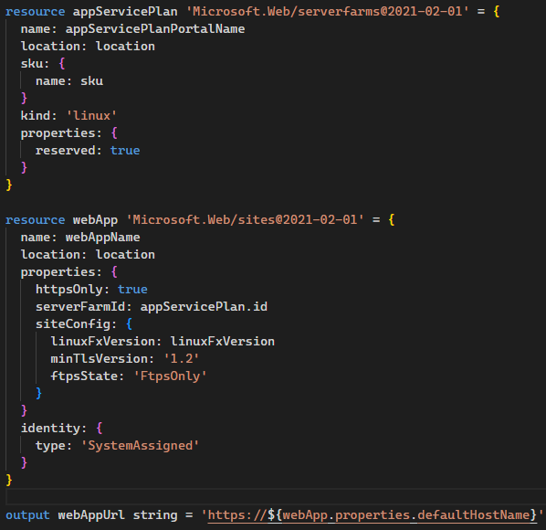
Bicep Example

Slide 23
Bicep References
Discover Bicep on MS Learn:
https://docs.microsoft.com/en-us/azure/azure-resource-manager/bicep/learn-bicep
Azure Bicep templates on GitHub:
github.com/azure/bicep

Slide 24
Terraform

Slide 25
Terraform with Azure
Open-source tool for provisioning and managing cloud infrastructure
Automated infrastructure management with templates
CLI allows users to validate and preview infrastructure changes
Deploy infrastructure to multiple clouds
Integrates with Azure DevOps and GitHub Actions

Slide 26
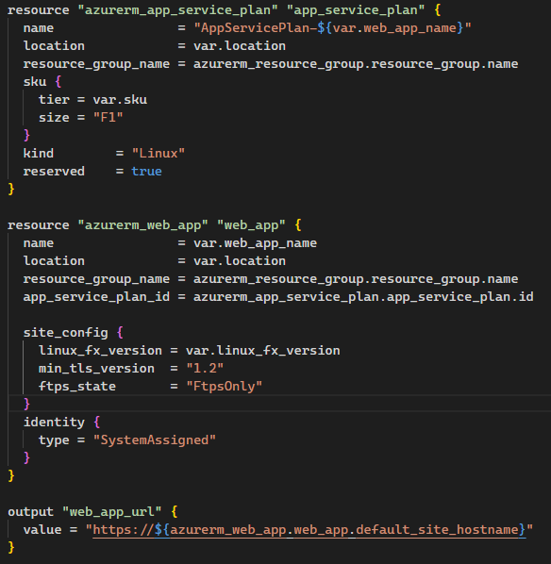
Terraform Example

Slide 27
Terraform References
Quick start guides
https://docs.microsoft.com/en-us/azure/terraform/terrafom-quickstart
Azure Documentation
https://docs.microsoft.com/en-us/azure/terraform/
Hashicorp Terraform Documentation
https://aka.ms/terraform

Slide 28
Bicep x Terraform

Slide 29
DEMO
Notes:
Folder: Demos/Example-00
Objective: To show the differences between ARM / BICEP / Terraform.
To discuss how difficult it is to maintain an ARM and how this management is made easier when we use Bicep or Terraform

